Slide 1
JavaScript Challenge 2023
Budget Buddy by Reena Mohun

Slide 2
Challenge Brief
Background context: With the UK experiencing the biggest price hike for fifty years, we challenge you to build a product, app, or website that will empower everyday citizens to manage their budgets and help alleviate the challenges of the current cost of living crisis.
The aim is to help people through the cost of living crisis.

Slide 3
My approach
From the brief I decided to build a budget app to showcase what I have learnt from the MOOC and a tool that I would use to help myself budget during this crisis.
I have built an app where you can record your income, expenses and track how much money you have left at the end of the month.
The features include different tabs for the income, expense, summary and some useful resources to help get advice on budgeting.
You can also amend entries, delete incorrect entries and add new entries.
There is also a summary graph visually indicating how much money has come in and gone out.

Slide 4




Technology used

Slide 5
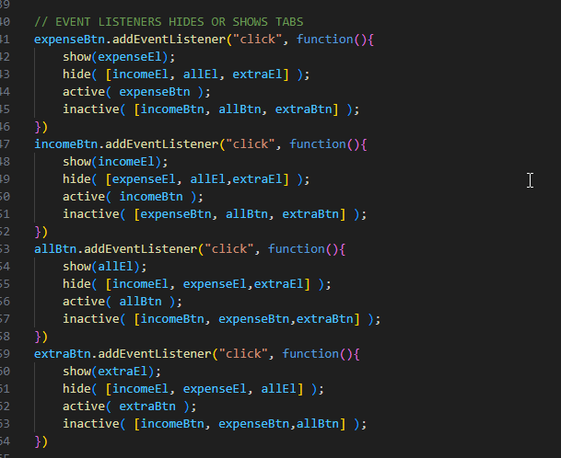
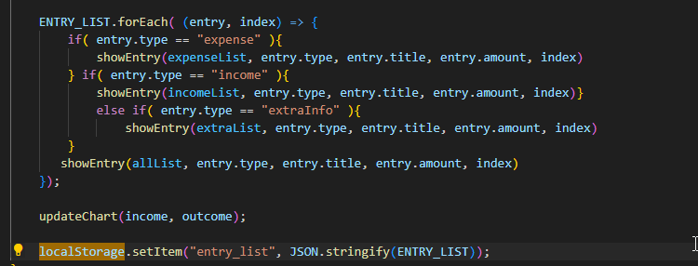
Highlights of code
Example of an array to show and hide elements on the tabs
Example of functions to create a chart to display expenses and income.

Slide 6
New things I learnt
I learnt how to:
The code:
Create a local storage to enable users to save their entries to their computer.
I used the window localStorage object to store the key/value pairs in the browser.

Slide 7
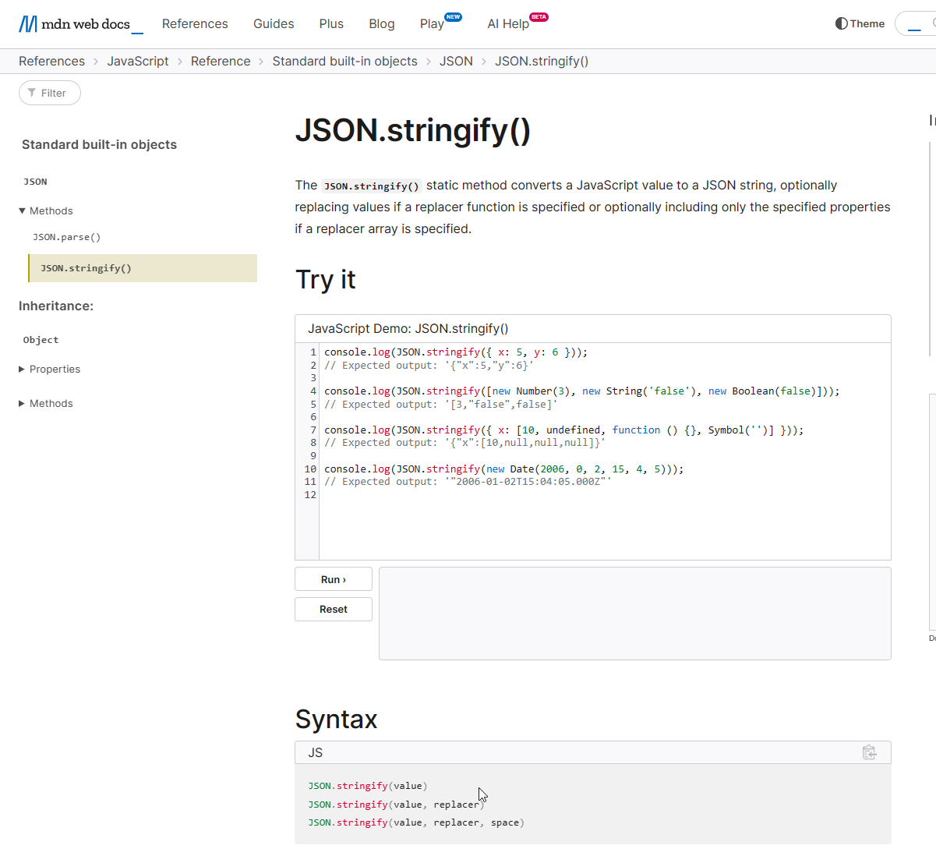
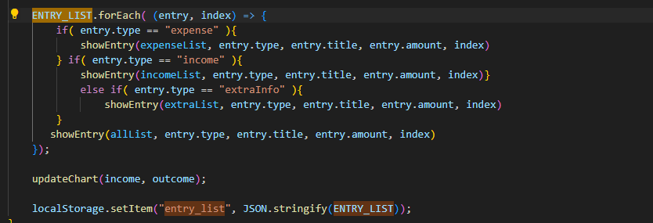
Troubleshooting
Used JSON.stringify() - JavaScript | MDN (mozilla.org) to find resolution.
Struggled to get the entry list to display realised I needed to convert to a JSON string.

Slide 8


Future Improvement
For a Version 2 of this application, I would love to add extra functionality to add templates.
For example with pre-existing fields for different types of people like students, parents, homeowners, renters etc.

Slide 9
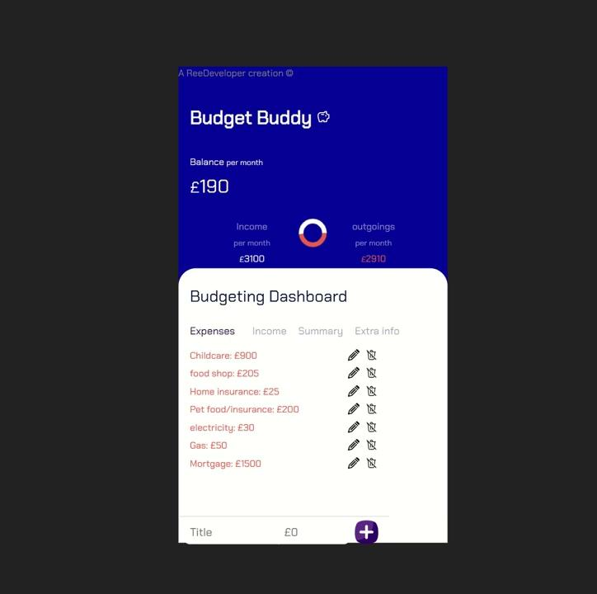
Demo of Budget Buddy App Click here to view Budget Buddy

Slide 10
Thank you for reading!
By Reena Mohun

